Slide 1
JQuery

Slide 2

Presenter
Rasool Naguru : I have been working in IT industry around 7 years. My Passion is towards building applications on SharePoint Platform ,Web designing and Data Migrations from Lotus Notes to SharePoint, SharePoint to SharePoint. I worked with 2 generations of SharePoint Products.

Slide 3
Agenda
JQuery Vs JavaScript
Introduction to jQuery
Introduction to DOM
Adding jQuery to a Page
jQuery Hello World example
jQuery selectors
HTML Controls
Events
Introduction CSS
Adding CSS into a Page
jQuery UI Interactions
jQuery UI User Interface Elements

Slide 4
JQuery Vs JavaScript
JavaScript is a language.
jQuery is a library written in JavaScript.
To help JavaScript programmers who are doing common web tasks.

Slide 5

Introduction to jQuery

Slide 6
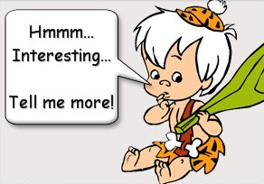
document.getElementById('ifYes').style.visibility = ‘hidden';
$(“#ifyes”).hide();

Slide 7
Introduction to jQuery
jQuery is an open source
jQuery is a lightweight
Do more things within one line
Simplifies the interaction between HTML and JavaScript.
Created by John Resig in 2005, released in January of 2006.
Tons of plugins, and it was recently adopted by Microsoft
Everything works in IE 6+, Firefox 2+, Safari 3+, Chrome, and Opera 9+
Who uses jQuery?
Microsoft, Google, Mozilla, IBM, Amazon, HP, Intel.
Ruby on Rails, Wordpress, Django, Drupal, CakePHP, ASP.NET MVC.

Slide 8
Introduction to DOM
Document Object Model
jQuery is “DOM scripting”
Hierarchal structure of a web page
You can add and subtract DOM elements on the fly
You can change the properties and contents of DOM elements on the fly.
It is a cross-platform and language-independent convention for representing and interacting with objects in HTML, XHTML and XML documents.

Slide 9
DOM Scripting
var x,y;
if (self.innerHeight) { // all except Explorer
x = self.innerWidth;
y = self.innerHeight;
}
else if (document.documentElement &&
document.documentElement.clientHeight) {
// Explorer 6 Strict Mode
x = document.documentElement.clientWidth;
y = document.documentElement.clientHeight;
}
else if (document.body) { // other Explorers
x = document.body.clientWidth;
y = document.body.clientHeight;
}
Notes:
From PPK

Slide 10
jQuery Scripting
var x = $(window).width();
var y = $(window).height();

Slide 11
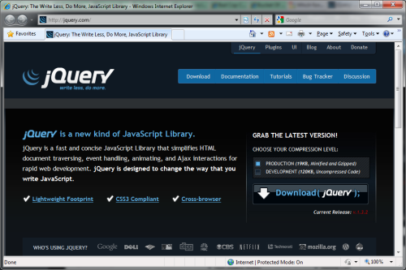
Download the latest version from http://jquery.com

Slide 12
Reference it in your markup
<script src=“jquery.js”/>
<script src=“http://ajax.googleapis.com/ ajax/libs/jquery/1.2.6/ jquery.min.js”> </script>

Slide 13




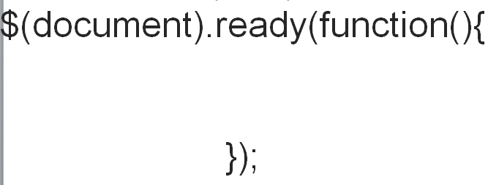
The Magic $() function

Slide 14
jQuery: Getting started
To start, we need a copy of the jQuery library and include a reference to it on our webpage –
1. Download a copy from [ http://jquery.com ]
<script src="path to the local jQuery file"></script>
OR
2. Let Google host it for you
<script src=https://ajax.googleapis.com/ajax/libs/jquery/1.7.2/jquery.min.js/>

Slide 15
Adding jQuery to a Page
<html>
<head>
<title>jQuery Hello World</title></head>
</html>
<script type="text/javascript" src="C:\Users\naguru\Desktop\Jquery Training\Jquery Plugins\jquery-1.4.2.min.js"></script>
<script type="text/javascript">
$(document).ready(function()
// jQuery(document).ready(function(){
{
alert("Welcome to Jquery Training Program");
});
</script>

Slide 16
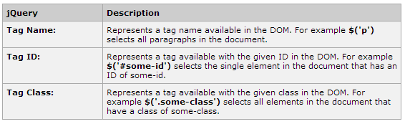
jQuery: Selectors
A jQuery Selector is a function which makes use of expressions to find out matching elements
The factory function $() makes use of following three building blocks while selecting elements in a given document:

Slide 17
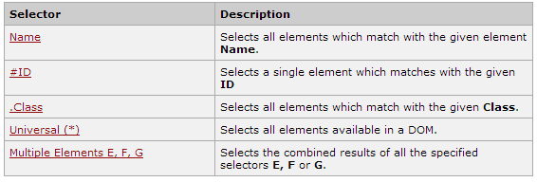
How to use Selectors
The selectors are very useful and would be required at every step while using jQuery.
They get the exact element that you want from your HTML document.

Slide 18
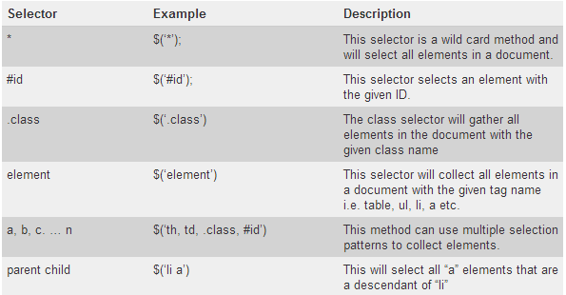
Examples for Selectors

Slide 19
HTML Controls and JQuery
Textbox 5. Checkboxes
Password 6. Textarea
Dropdown menu 7. Buttons
Radio buttons
To get values for Controls by using following methods
$('input[id$="txtName"]').val(); //Get Value
$('input[id$="txtName"]').val(“data”); //set Value
$('select[id$=“ctrlID"]').val();
$("#ctrlID").val();

Slide 20

Radio Buttons
$('input:radio[name=gender]:checked').val()

Slide 21
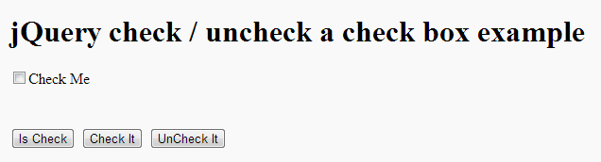
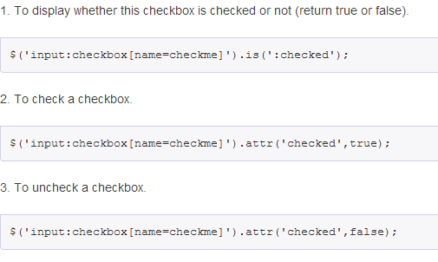
Checkbox checked/unchecked

Slide 22
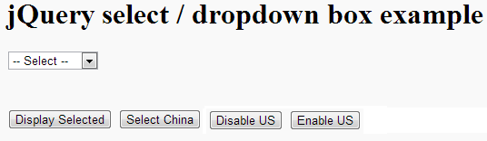
Dropdown / select
$("#country").val("China"); //To set Value
$("#country").val(); //To get Value
$("#country option[value='United State']").attr("disabled", true); //To Disable option in dropdown
$("#country option[value='United State']").attr("disabled", false); //To Enable Option in dropdown

Slide 23
Events
An event occurs as a result of some activity
e.g.:
A user clicks on a link in a page
Button click
Page finished loaded
Mouse cursor enter an area
A preset amount of time elapses
A form is being submitted

Slide 24
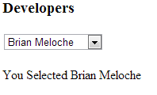
Select Change Event
$("#selectBoxId").change(function(){ alert(“fired”); });
$("#selectBoxId").change( yourfunctionname );

Slide 25
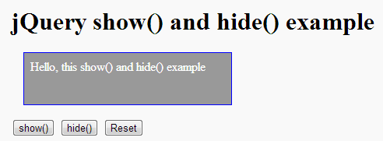
Hide & Show

Slide 26

Introduction CSS
Cascading Style Sheets, fondly referred to as CSS, is a simple design language intended to simplify the process of making web pages presentable.
CSS handles the look and feel part of a web page.
Using CSS, you can control the color of the text, the style of fonts, the spacing between paragraphs, how columns are sized and laid out, what background images or colors are used, as well as a variety of other effects.

Slide 27


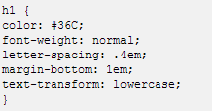

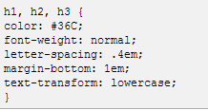


Slide 28
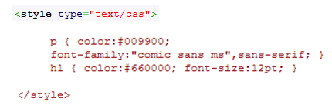
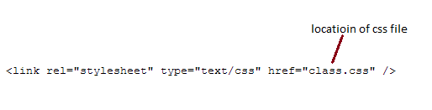
How to Add
In Html
Embedded CSS file in HTML page

Slide 29
jQuery UI Interactions
Draggable
Droppable
Resizable
Selectable
Sortable

Slide 30
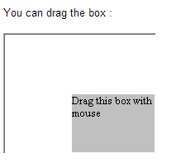
Draggable

Slide 31
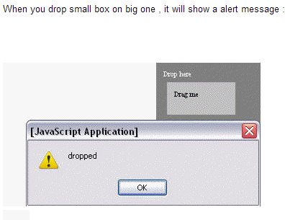
Droppable

Slide 32
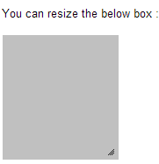
Resizable

Slide 33
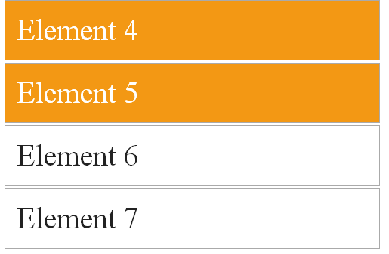
Selectable
You can select element/elements by click and also by holding ctrl key or by holding left key of mouse

Slide 34
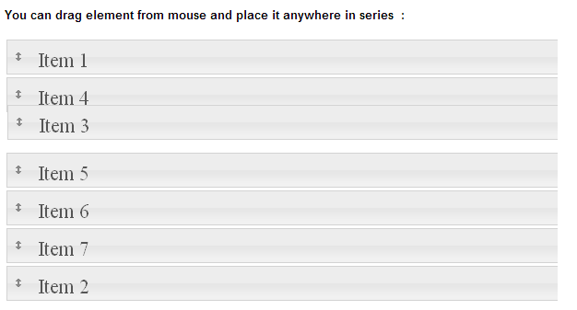
Sortable

Slide 35
jQuery UI User Interface
Accordion
Autocomplete
Button
Datepicker
Dialog
Progressbar
Slider
Tabs
Animated One
Menus

Slide 36
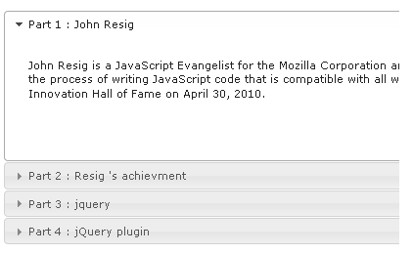
Accordion

Slide 37
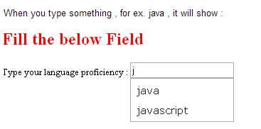
Autocomplete

Slide 38

Button

Slide 39
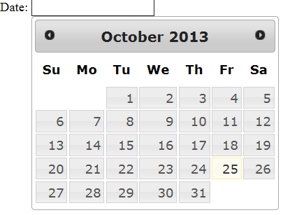
Datepicker

Slide 40
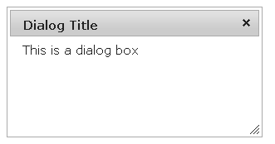
Dialog Box

Slide 41
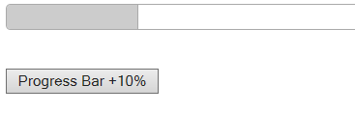
Progressbar

Slide 42

Slider

Slide 43
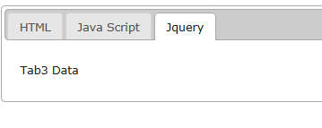
Tabs

Slide 44
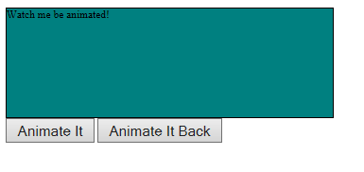
Animated One

Slide 45
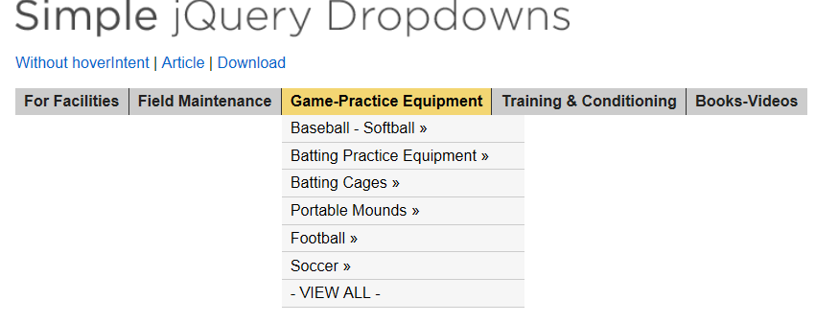
Menus

Slide 46
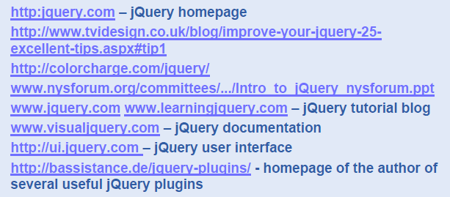
jQuery: References

Slide 47
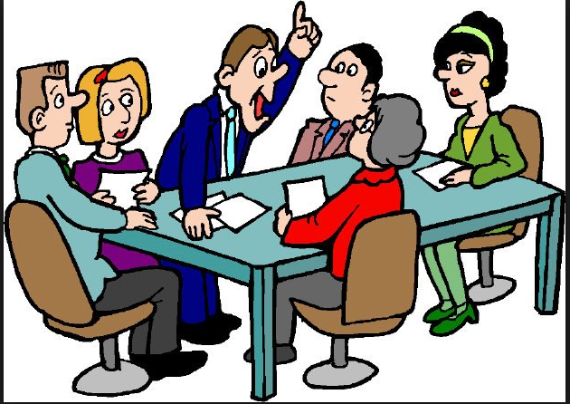
Q & A

Slide 48

Thank You

